Slide 1
SMART INDIA HACKTHON
PROJECT : FITNESS & SPORTS
TEAM NAME : NSUT HUNTERS
TEAM MEMBERS:
LOVEKUSH
ANUJ SURYAVANSHI
ANSHIKA PAWAR
ADITYA BHATT
SHEENA INDORIA
AMAN YADAV

Slide 2
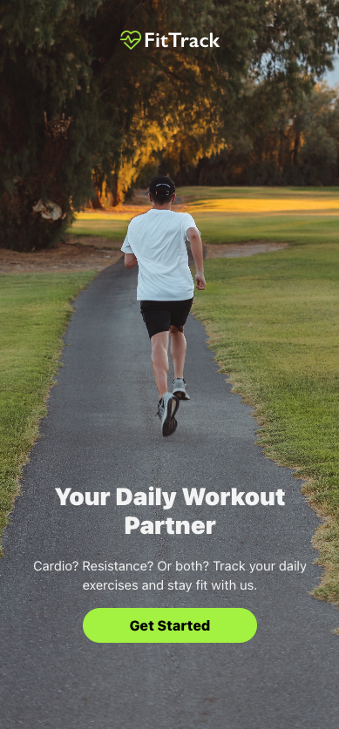
PROBLEM STATEMENT : Many individuals find it challenging to maintain consistent workout routines, often because proper tracking and motivation are lacking. Whether focused on weight loss, muscle gain, or general fitness, users encounter difficulties in tracking exercise progress, selecting suitable workouts, and sustaining motivation. Without a streamlined platform, effectively managing and optimizing their fitness journeys proves to be quite difficult.
WEB PAGE of website : whose name is “ FitTrack”
Whose moto is to BECOME A DAILY WORKOUT PARTNER
Also AIM is to achieve a LIFE PARTNER
POSITION who helps to become FITNESS FREAK PERSON.

Slide 3
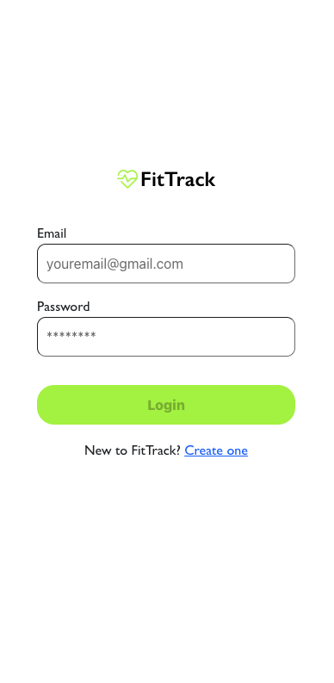
LOGIN PAGE : login page of FIT TRACK
IN WHICH we write our E-mail and create our Password to login in the
website
PROPOSED SOLUTION :
FitTrack offers a comprehensive platform for tracking workouts, enabling users to monitor daily exercise routines—cardio and resistance training alike. With this app, workouts can be logged, progress tracked over time, and fitness goals managed in a structured manner. Users benefit from an intuitive interface that simplifies the logging of details such as distance, duration, weight, sets, and reps, ensuring they remain committed to their fitness regimen.

Slide 4
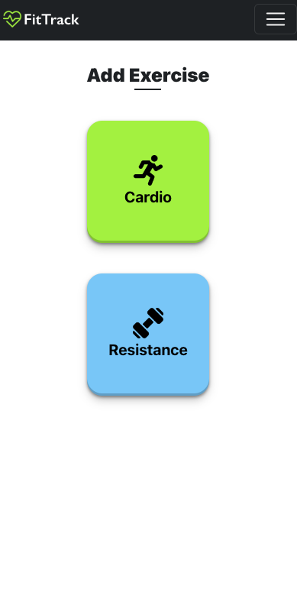
Unique Selling Propositions (USPs):
)Dual Exercise Focus: FitTrack accommodates both cardio and resistance training, making it suitable for a wide range of fitness goals.
2.)User-Friendly Interface: The clean, visually appealing design ensures that users can easily navigate through the app and log their exercises without hassle.
3.)Progress Tracking: The app provides a history feature where users can view their past workouts, allowing them to track their progress and make informed decisions about their fitness routines.
4.)Personalized Experience: Users can create their accounts, ensuring that their workout data is securely stored and easily accessible across devices.
5.)Motivation & Consistency: The app encourages regular workouts by making exercise logging simple and providing a clear overview of user progress, thus motivating users to stay consistent.

Slide 5
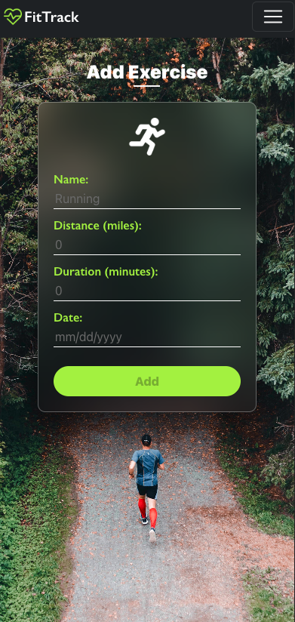
Business Model:
Freemium Model:
Free Tier: Basic features like logging exercises, viewing workout history, and setting up cardio and resistance training routines.
Premium Tier: Advanced analytics, personalized workout plans, integration with wearables, and community features for social motivation.
Subscription Model:
Monthly or annual subscriptions that unlock premium features like advanced tracking, workout suggestions, and detailed progress reports.
In-App Purchases:
Sell personalized workout plans, diet plans, and virtual coaching sessions.
Partnerships & Advertisements:
Partner with fitness brands to promote gear or supplements. Offer in-app advertisements for fitness-related products and services.

Slide 6
Tech Stack we used to CREATE this WEBSITE :
Frontend:
React Native: For developing a cross-platform mobile application that runs smoothly on both iOS and Android.
HTML5, CSS3, JavaScript: For the web version, ensuring a responsive and interactive user interface.
Backend:
Node.js with Express.js: To handle server-side operations and API requests efficiently.
MongoDB: For a scalable, NoSQL database solution that manages user data and workout logs.
Authentication & Security:
Firebase Authentication: For secure user authentication and easy integration with social logins.
JWT (JSON Web Tokens): For secure and scalable session management.
APIs & Integration:
Google Fit/Apple Health Integration: To sync user activity data seamlessly.
Stripe: For handling payments securely within the app.
Cloud & Hosting:
AWS or Google Cloud: For hosting the backend, ensuring reliability, scalability, and security.
Firebase Storage: For storing user-generated content, like images or progress photos.

Slide 7
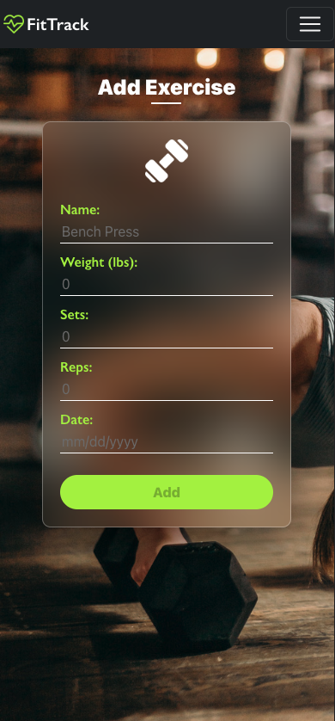
IN THIS SECTION :
you can add exercise which you want to add
: Name of exercise
: Weight
: Sets
: Reps
: Date
This will help YOU to examine your “ PROGRESS” on daily basis
What you do .

Slide 8
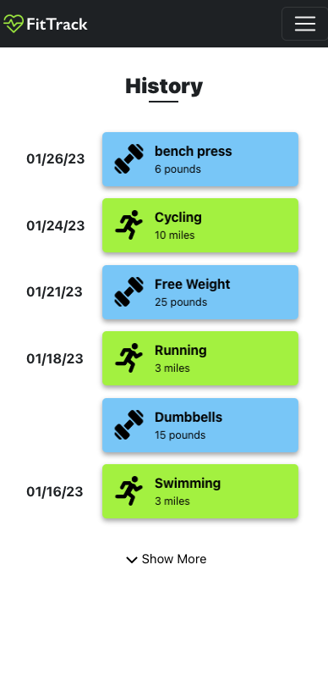
Through using of these
you can reuse same sets to complete your fitness and Types of exercise
you want to do .
This also helps for COLLEGE GOING students to examine HOW a student can examine his WEEKLY FITNESS.
THIS WILL HELPS YOU TO
helps in WEIGHT GAIN ,WEIGHT LOSS
and also in FITNESS FREAK PEOPLE.

Slide 9
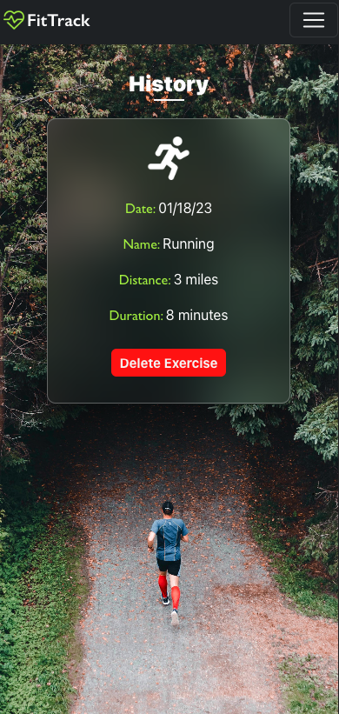
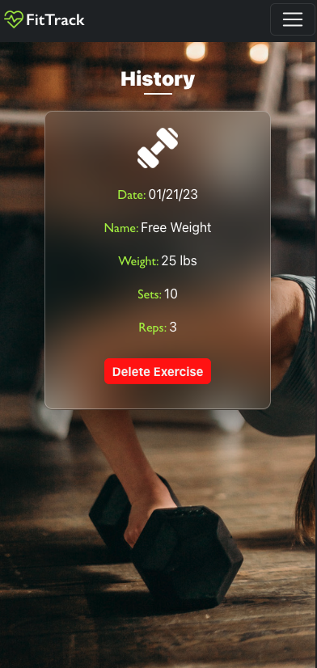
THERE ARE MORE HISTORY
EXAMPLE TO TRACK THE FITNESS
LEVEL and weight puts out in daily
routine to get a healthy lifestyle .

Slide 10
THANK YOU

